Slide 1


Big Data Insights

Slide 2


Agenda
Project recap
Problem
Analyst Background
Process
Insights
Recommendation

Slide 3

Due to the rapid growth and digital nature of content products, the amount of data that is been created and collected is huge.
All these data requires structuring and managing.
Hence, there is a need to hire analytical teams to help in providing business insights for the purpose of marketing and product development.
I analysed the content categories that highlights the top 5 categories with the largest aggregate popularity.
Project Recap

Slide 4


Problem
500 million active users
100,000 posted contents/day
What content categories are the most popular in order to focus marketing and product development efforts.

Slide 5

The Analytics team
Ewoyi Itodo
Student at BrainStation | Data Analyst

Slide 6
Process
1
Collected, cleaned, and merged the sample dataset tables by removing duplicates with Excel.
2
The data was analysed using a variety of methods, including pivot tables.
3
The top 5 content categories with the largest aggregate popularity were identified.
4
Insights from the big data analysis were generated.
5
Generated Visuals

Slide 7
Statistical Analysis
1
Count of the distinct categories
2
Population count of the content categories
3
Determined the top rated categories based on their scores
4
Count of reactions to the most popular content category
5
Developed a post trend

Slide 8

Insights
3.
The month with the highest amount of contents posted was “May”
2.
The category with the highest amount of reactions was ”animal”
1.
There are 16 unique categories

Slide 10
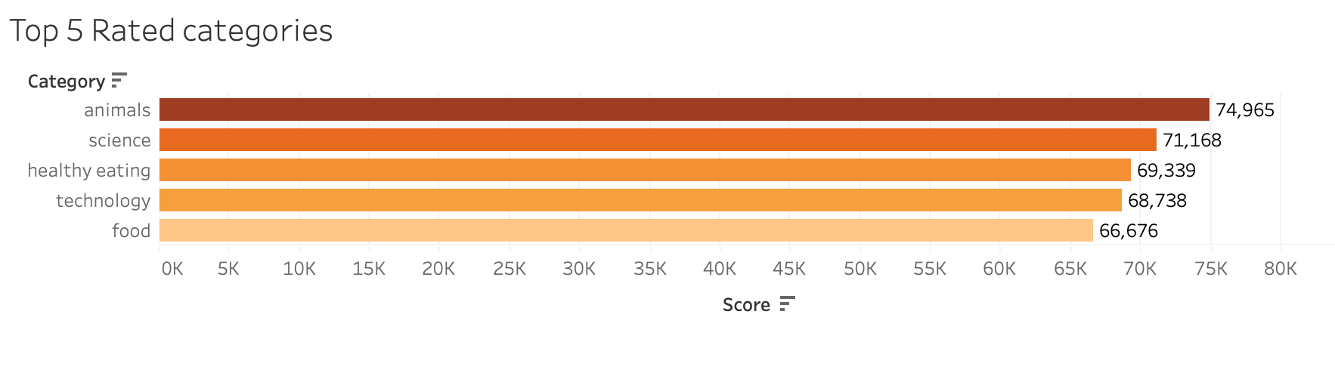

Slide 11
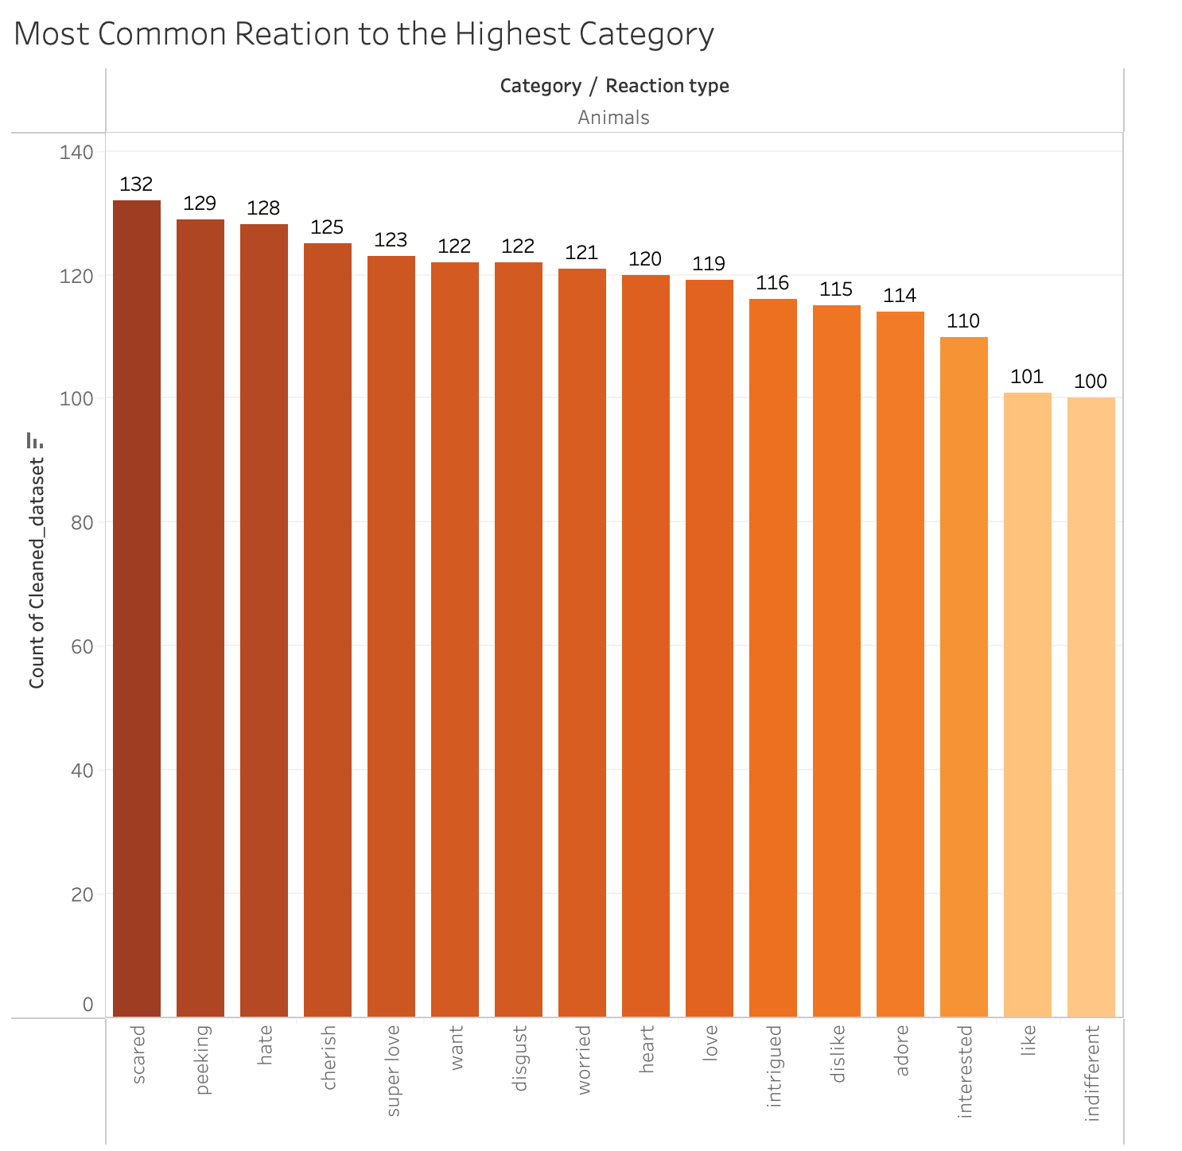

Slide 12
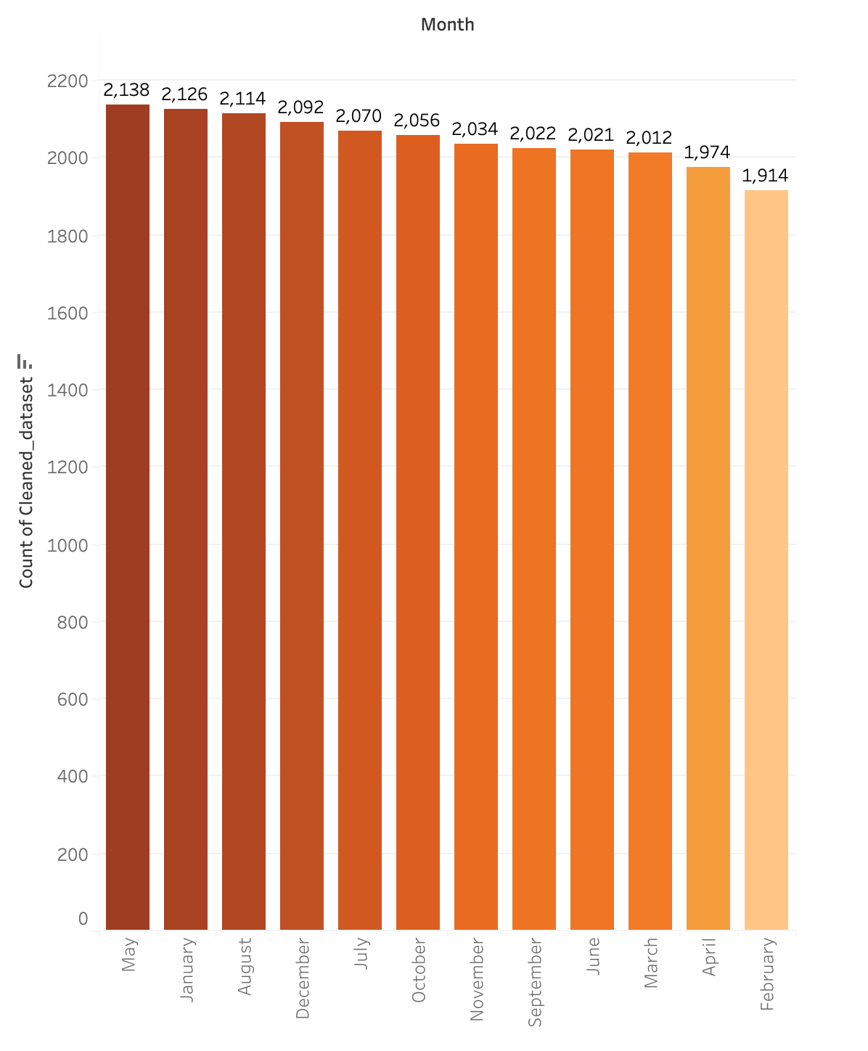

Slide 13
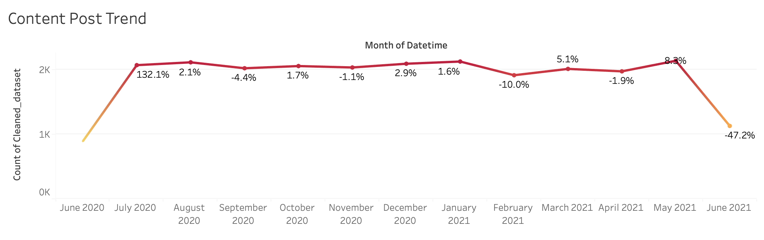

Slide 14

Emphases should be placed on the top 5 categories for the purpose of marketing and product development.
More contents regarding these categories would increase participation amongst users especially in areas of technology since we are in a digital age
Hence collaborating with tech brands will be good idea.
By doing this, a competitive edge will be put in place for whatever company that needs this.
Recommendation

Slide 15

https://www.theforage.com/virtual-internships/prototype/hzmoNKtzvAzXsEqx8/Data-Analytics-Virtual-Experience?ref=Zpx59NhYRQBaqBQgv
Appendix

Slide 16
Thank you!
ANY QUESTIONS?

